Slide 1


Bitcoin Scalability -- Cryptocurrencies for the Masses
LING Zong, Ph. D.
Senior Software Engineer / Scientist
IBM Almaden Research Center
San Jose, California, U.S.A.
Notes:
Thanks, pleasure etc.
There is much hype around Blockchain.
Most of this relates to the use of Blockchain to underpin the Bitcoin crypto currency.
Whilst IBM are not interested in Crypto currency, we are very interested in exploring the broader business application of Blockchain technology. This is a transformational opportunity for many of our clients
This touches most all industries – we are making Blockchain REAL for business.

Slide 2
Lecture Outline
Scalability Problem for Bitcoin
Proposed Scalability Solutions
Blocksize Capacity Increase
Segregated Witness
Sidechains
Lightning Network

Slide 3
Scalability Problem for Bitcoin

Slide 4
Bitcoin Scalability Problem
The bitcoin scalability problem refers to the discussion concerning the limits on the amount of transactions the bitcoin network can process. It is related to the fact that records (known as blocks) in the bitcoin blockchain are limited in size and frequency.
Bitcoin's blocks contain the transactions on the bitcoin network.
The on chain transaction processing capacity of the bitcoin network is limited by the average block creation time of 10 minutes and the block size limit.
These jointly constrain the network's throughput. The transaction processing capacity maximum is estimated between 3.3 and 7 transactions per second.
There are various proposed and activated solutions to address this issue.
Notes:
https://en.wikipedia.org/wiki/Bitcoin_scalability_problem

Slide 5
Scalability
Scalability: In this context, the ability of a system to deal with increased transaction volume.
We typically use the unit tps, or transactions per second, to describe the scalability of a financial system such as Bitcoin.
When thinking about scalability, should also think about size along with velocity.
Bitcoin Blockchain is currently already 80 Gb.
Can we make it so that nodes can store it efficiently into the future?

Slide 6
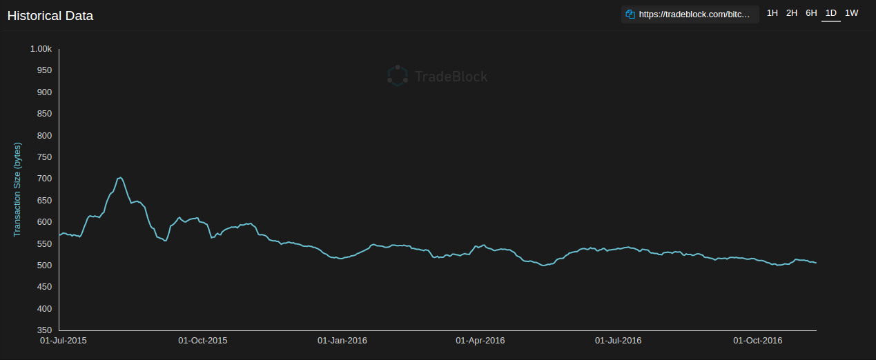

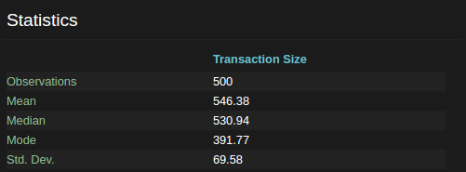
https://tradeblock.com/bitcoin/historical/1d-f-tsize_per_avg-00271

Slide 7

Bitcoin’s Current Scalability
From previous slide:
Average of 546 bytes per transaction.
Current blocksize is 1 MiB.
Expected time to next block is 10 min.
Therefore we can compute the sustained maximum transaction volume in tps:

Slide 8
Scalability Comparison
How does Bitcoin compare with other traditional payment systems?
 | Average | High Load / Maximum
Bitcoin | 2.2 tps | 3.2 tps
PayPal* | 150 tps | 450 tps
VISA** | 2,000 tps | 56,000 tps
* http://www.fool.com/investing/general/2016/02/04/5-things-paypal-holdings-inc-wants-you-to-know.aspx
** https://usa.visa.com/dam/VCOM/download/corporate/media/visa-fact-sheet-Jun2015.pdf
Notes:
PayPal processed 450 payments per second on Cyber Monday last year.
VisaNet is capable of processing 56,000 transaction messages a second

Slide 9
Bitcoin’s Current Scalability
From previous slide:
Average of 546 bytes per transaction.
Current blocksize is 1 MiB.
Expected time to next block is 10 min.
Therefore we can compute the sustained maximum transaction volume in tps:
What are the variables we can play with?
Size of blocks
Size of transactions
Block creation rate
Whether transactions get added

Slide 10
Naive Solution
Just increase the speed of blocks. Easiest solution. Just decrease the nonce.
Cons:
Less propagation time
More Block Orphaning
More people find solutions at the same time
Mess up halving
More Frequent Forks
Therefore potential for double spends
Less likely to be accepted than increasing blocksize
Seen as a fundamental part of the protocol, rather than just a protective soft limit
Less time for confirmations but like not really, cause you now need more confirmations

Slide 11
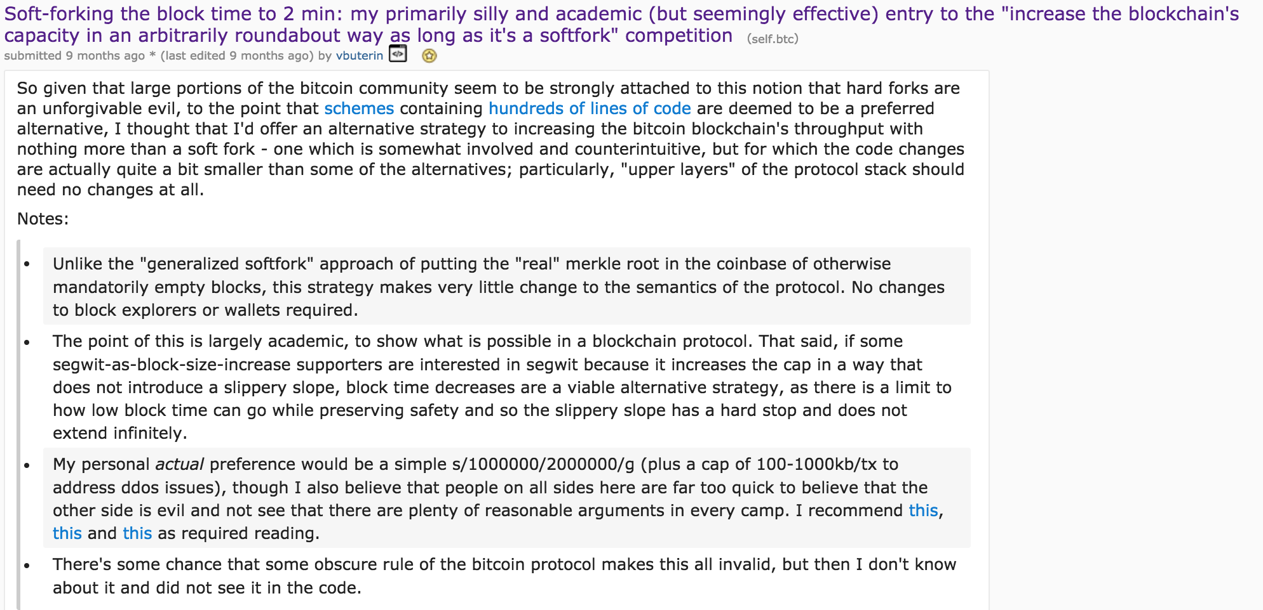
Naive Solution
Here is Vitalik Buterin, creator of Ethereum, proposing exactly that and being completely ignored.
Notes:
Purely academic, and was more of a protest against segregated witness.
But it works, and is pretty good.

Slide 12
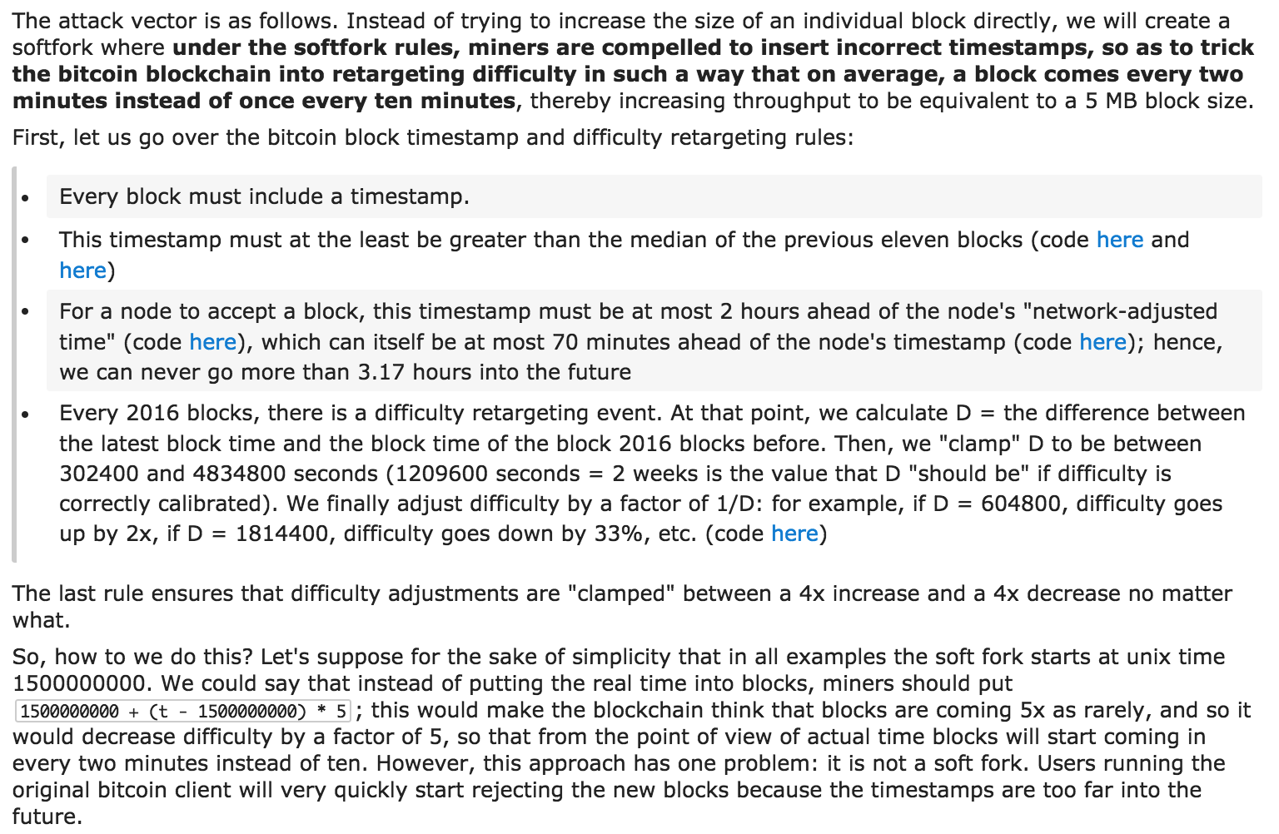
Notes:
Tl’dr is that basically miners agree to lie to the system and claim false timestamps that are 10 minutes later, but in reality are only 2 minutes later.
You can trick the system into giving easier nonces. Some wizard math to make this work around the timestamp restrictions we mentioned in a previous lecture.
Once again, this is just to poke fun at the idea of using absurd complicated soft forks over hard forks.

Slide 13
Naive Solution
But wait, Ethereum has 17 second block times.
Less time for confirmations but like not really, cause you now need more confirmations
Pros and Cons
https://blog.ethereum.org/2015/09/14/on-slow-and-fast-block-times/
Or, read：On Slow and Fast Block Times.DOC

Slide 14
Proposed Scalability Solutions
Blocksize Capacity Increase
Segregated Witness
Sidechains
Lightning Network

Slide 15
Block Capacity Increase

Slide 16
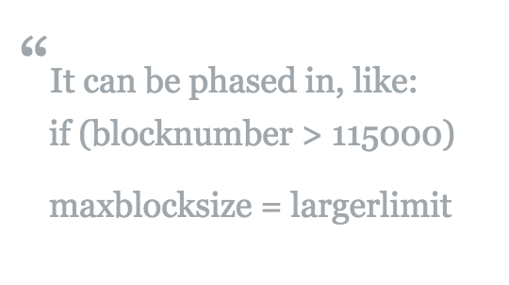

Increase the Block Size
The block size limit has created a bottleneck in bitcoin, resulting in increasing transaction fees and delayed processing of transactions that cannot be fit into a block.
Various proposals have come forth on how to scale bitcoin, and a contentious debate has resulted. Business Insider in 2017 characterized this debate as an "ideological battle over bitcoin's future."
Notes:
Larger blocks take longer to propagate and longer to validate. Other miners can only start working on a (non-empty) succeeding block once they've validated the current. Larger blocks therefore lead to a greater advantage for the authoring miner at finding also the next block.

Slide 17
Increase the Block Size
Idea: If we just increase the blocksize, we can fit more transactions in a single block.
Larger blocks take longer to propagate and longer to validate. Other miners can only start working on a (non-empty) succeeding block once they've validated the current. Larger blocks therefore lead to a greater advantage for the authoring miner at finding also the next block.
Pros:
It’s an “easy” implementation. Just get miners to agree (Obviously we know this isn’t easy).
Might have to do it for lightning network anyways
Lessen transaction fees (if you’re a user)
Cons:
Hard fork blah blah blah
Lessen transaction fees (if you’re a miner)
Size increases very fast
“Slippery slope”
Blockchain is already 80 Gb!
Longer Propagation Times
Authoring miner has better shot at next block
One time linear capacity increase
Temporary Fix

Slide 18
Examples
Bitcoin Classic
2 Mb
Bitcoin XT
8 Mb
Bitcoin Unlimited
Allows miner to accept a block larger than your maximum accepted blocksize if it reaches a certain number of blocks deep in the chain.
Essentially will make blocksize decided by “supply and demand” through a transaction fee market
Removes the only point of central control in the Bitcoin economy
Free-market economics will force consensus
Will adapt in real time to real-world conditions
Update on ViaBTC (https://www.viabtc.com/)
They were trying to stall SegWitness in support of Bitcoin Unlimited
They lost half their hashing power
SegWitness passed

Slide 19
Segregated Witness

Slide 20
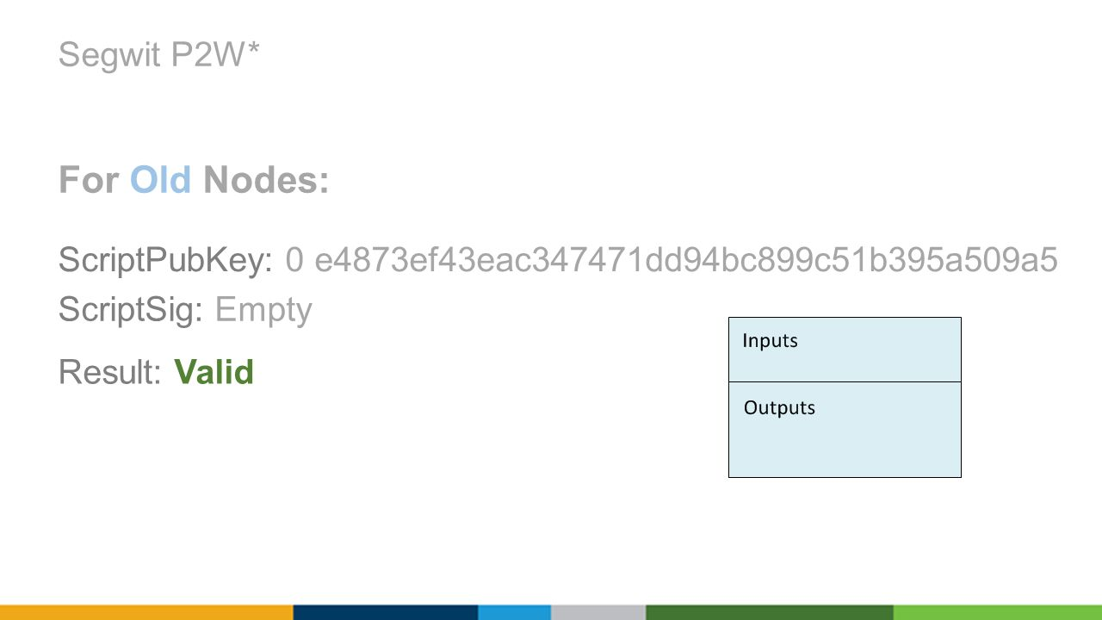
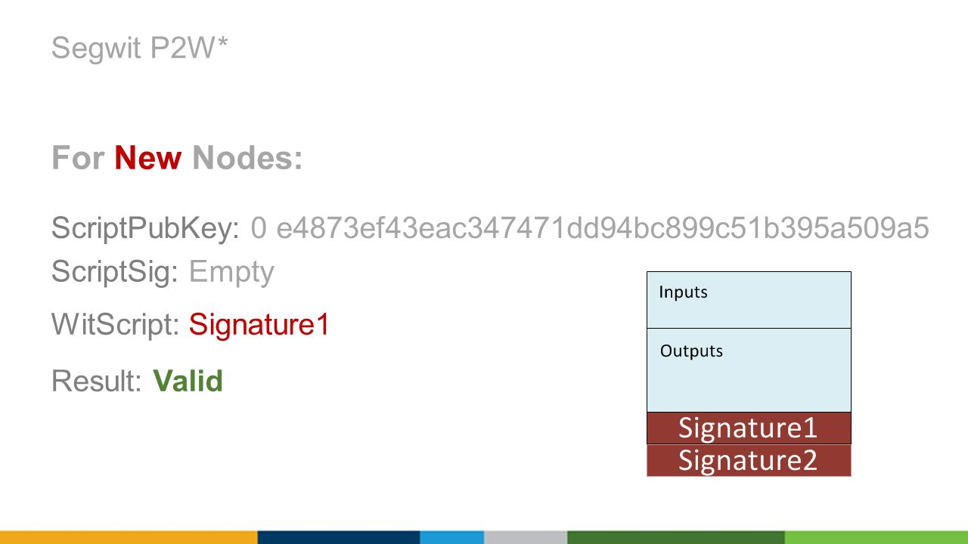
Segregated Witness
Idea: The digital signatures for each transaction take up a lot of space in each block. There’s no reason they need to be there. Let’s remove them.
How:
Notes:
Currently, the signatures are kept in scriptPubKeys.
Move this to a seperate add-on outside of the scriptPubKey, a segregated witness. New nodes will see the new scriptPubKeys and know to look in the segregated witness. Old nodes will find these new scriptPubKeys crazy. They will think that anyone can create a new scriptSig, unlocking these outputs, meaning they're highly insecure. But at the same time, old nodes won't mind either. After all, it's not their bitcoin that's being messed around with, and other people are free to do with their bitcoin as they please. The meaningless text will be considered weird, but fine too. So they'll confirm the transactions as valid, and forward it to other nodes.

Slide 21
Segregated Witness
Segregated Witness (abbreviated as SegWit) is an implemented protocol upgrade intended to provide protection from transaction malleability and increase block capacity.
SegWit separates the witness from the list of inputs. The witness contains data required to check transaction validity but is not required to determine transaction effects.
Additionally, a new weight parameter is defined, and blocks are allowed to have at most 4 million weight units (WU). Non-witness and pre-segwit witness bytes weigh 4 WU, but each byte of Segwit witness data only weighs 1 WU, allowing blocks that are larger than 1 MB without a hardforking change.
But now, the blockchain doesn’t have any evidence that correct signatures were included in transactions.
A SegWit miner creates a Merkle tree out of segregated witnesses that mirrors the transaction tree
This tree’s merkel root is included in the input field of the coinbase transaction.
This changes the transaction ID of the coinbase transaction
Therefore signatures influence the block header and, ultimately, the makeup of the blockchain.
After the successful activations of OP_CLTV and OP_CSV, SegWit was the last protocol change needed to make the Lightning Network safe to deploy on the Bitcoin network.
Because the new witness field contains Script versioning, it is also possible to make changes to or introduce new opcodes to SegWit scripts that would have originally required additional complexity to function without SegWit.
---- https://en.bitcoin.it/wiki/Segregated_Witness
Notes:
Segregated Witness-enabled miner adds a trick, too. Rather than creating only a Merkle Tree out of all of the transactions, it also creates a Merkle Tree out of all Segregated Witnesses, to mirror the transaction tree. The Segregated Witness Merkle Root, then, is included in the input field of the coinbase transaction. As such the Segregated Witness Merkle Root changes the transaction data of the coinbase transaction, its transaction ID, therefore influences the block header and, ultimately, the makeup of the blockchain.

Slide 22
Segregated Witness
History and Activation: During 2016 and 2017 activation of segregated witness was blocked by miners for political reasons by exploiting a flaw in the BIP 9 activation mechanism. On a technical level, the consensus rules of bitcoin are controlled by the economic majority not the miners, so the deadlock was possible to solve by creating a user activated soft fork BIP 148 where the economic majority would bypass the blocking miners and activate segregated witness on their own. This required some coordination amongst the economic majority, but was ultimately successful, activating Segwit on Bitcoin soon after 1st August 2017.
Pros:
Only soft fork
Fixes Transaction Malleability
Allows Lightning Network and sidechains to work
No slippery slope
Efficiency Gains
Smaller Size of Blockchain
Cons:
One time linear capacity increase
Introduces new type of DOS attack (go-fish-wit-ddos)
Very complicated and ugly (Over 500 lines of code)
Other ways to solve maleability
Wallets have to incorporate it
Introduces a new type of DOS attack (go-fish-wit-ddos)
An attacker mines a segwit-block with 1000 transactions the network has not yet seen (The attacker creates these TX herself ) The attacker has the witness data readily available. When other miners try to validate this block they will go through every single one of these TX and say "I don't have the witness data for this TX_ID, I have to call TCP::GetWitnessData( TX_ID ) aw yes this is valid"

Slide 23
Schnorr Multisignatures
Schnorr signatures are a method of improving the capacity of the Bitcoin network through the aggregation of signatures required for a Bitcoin transaction.
Idea: Instead of requiring the signatures of every member, combines them and only has one signature
Pros:
Can be implemented with either soft or hard fork (cleaner with hard fork)
Multisig transactions will be significantly smaller
Faster verification
Plausible deniability for participants
Why wasn’t it implemented?
When bitcoin first came out, ECDSA was the most popular because Schnorrs was still under patent protection. It’s not anymore. Pretty much better in every way. Just needs someone to implement it.
https://en.wikipedia.org/wiki/Schnorr_signature
Notes:
https://en.wikipedia.org/wiki/Elliptic_Curve_Digital_Signature_Algorithm

Slide 24
Bitcoin’s Current Scalability
What are the variables we can play with?
Size of blocks
Size of transactions
Block creation rate
Now what?
We need to change something else. Let’s just not use the blockchain!

Slide 25
Sidechains

Slide 26
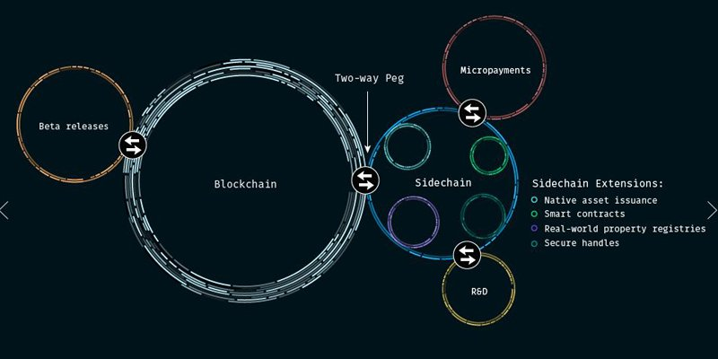
Sidechains
A sidechain or pegged sidechain enables bitcoins and other ledger assets to be transferred between multiple blockchains. This gives users access to new and innovative cryptocurrency systems using the assets they already own. By reusing Bitcoin's currency, these systems can more easily interoperate with each other and with Bitcoin, avoiding the liquidity shortages and market fluctuations associated with new currencies. Since sidechains are separate systems, technical and economic innovation is not hindered. Despite bidirectional transferability between Bitcoin and pegged sidechains, they are isolated: in the case of a cryptographic break (or malicious design) in a sidechain, the damage is entirely confined to the sidechain itself.
Idea:
With sidechains, one could move their bitcoin over to a faster, less-secure blockchain for purchasing their morning coffee. The fact that a sidechain has a much larger block size limit would be less of an issue when the chain is only being used for small, unimportant transactions.
Pros:
Less things on bitcoin blockchain, but can still be pegged to it.
Cons:
Not “really” a solution. Just moved things to different chains.
https://en.bitcoin.it/wiki/Sidechain
Notes:
PEG指标(市盈率相对盈利增长比率)是用公司的市盈率除以公司的盈利增长速度。 Pegged v.用夹子或钉子固定(peg的过去式和过去分词); 使固定在某水平;

Slide 27
Recall:
Bitcoin Transactions:
When Alice wants to pay Bob 1 BTC, Alice signs a transaction, broadcasts it to the network, and Bob waits for some number of confirmations before he considers Alice’s payment to be valid.
By waiting for blocks to be mined on top of Alice’s payment, Bob can ensure that Alice can’t double spend and cheat Bob.
Idea:
Can Alice and Bob make payments between themselves without always needing to consult the blockchain to prevent one cheating the other?

Slide 28
Proposal:
What if Alice and Bob maintain a private balance sheet, updating the IOUs with every payment and only consult the blockchain when one party wants to settle?
Alice and Bob’s Balance Sheet
Alice and Bob’s Balance Sheet
Alice | Bob
10 BTC | 5 BTC
Alice pays Bob 2 BTC
Alice | Bob
8 BTC | 7 BTC

Slide 29
Private balances
Alice and Bob only make a transaction on the blockchain when they want to settle their private balances.
Alice and Bob’s Balance Sheet
Alice and Bob open a private balance sheet
Alice | Bob
10 BTC | 0 BTC
BLOCKCHAIN
Alice and Bob make several private txns.
Alice and Bob’s Balance Sheet
Alice | Bob
3 BTC | 7 BTC
Alice and Bob later close the balance sheet

Slide 30
Payment Channels
A Micropayment Channel or Payment Channel is class of techniques designed to allow users to make multiple Bitcoin transactions without committing all of the transactions to the Bitcoin blockchain.
In a typical payment channel, only two transactions are added to the block chain but an unlimited or nearly unlimited number of payments can be made between the participants.
Several channel designs have been proposed or implemented over the years. Many designs are vulnerable to transaction malleability. Specifically, many designs require a way to be able to spend an unsigned transaction, in order to ensure that the channel can be opened atomically. Thus, these designs require a malleability fix that separates the signatures from the part of the transaction that is hashed to form the txid.
Idea: Use Bitcoin script to create blockchain-enforceable contracts between Alice and Bob so that neither party can cheat the other, while maintaining the private balance sheet functionality!
In blockchain land, we call these payment channels.
How does this “payment channel” thing actually work?
Notes:
https://en.bitcoin.it/wiki/Payment_channels

Slide 31
Hash Time-locked Contract (HTLC)
The term Hashed TimeLock Contract (HTLC) refers to a special feature that is used to create smart contracts that are able to modify payment channels. Technically, the HTLC feature enables the implementation of time-bound transactions between two users. In practice, the recipient of a HTLC transaction has to acknowledge the payment by submitting a cryptographic proof within a specified timeframe (number of blocks). If the recipient forfeits or fails to claim the payment, the funds will be returned to the original sender. The HTLC feature is applied in both bidirectional and routed payment channels to allow the secure transfers of funds over various channels, without requiring trust on any of the intermediaries.
There are two key elements which distinguish HTLC from standard cryptocurrency transactions, which are:
Hashlock: a function that restricts the spending of funds until a certain piece of data is publicly disclosed (as a cryptographic proof). Such proof may also be referred to as the pre-image of the hashlock. The pre-image is simply the piece of information that is used to generate the hashlock, and to later unlock its funds.
Timelock: is a function that restricts the spending of funds until a specific time (or block height) in the future. It can be achieved in Bitcoin, for example, using functions like CheckLockTimeVerify or CheckSequenceVerify.
The Bitcoin Lightning Network is among the most popular use cases of Hashed Timelocked Contracts. By implementing HTLC into payment channels, funds can be transacted from user to user through interconnected payment channels, without requiring any level of trust. This process is known as network routing. It allows Alice to exchange funds with Carol even if they are not directly connected through a payment channel. HTLC’s enable Alice to send her funds to Carol through other participants of the network (e.g., Bob) - and the hashlock and timelock features ensure that Bob cannot intercept the funds. Besides being used on the Lightning Network, HTLCs can also be useful in other contexts, such as cross-chain atomic swaps, financial smart contracts and escrow, and much more.
https://captainaltcoin.com/hashed-timelock-contract-htlc/
https://academy.binance.com/glossary/hashed-timelock-contract /
Notes:
forfeit vt. （因违反协议、犯规、受罚等） 丧失，失去;

Slide 32
Notations
Briefly, some notations:
Alice is spending a 10 BTC txn output
Alice sends 3 BTC to Bob and 7 BTC back to herself.
From: Someone
10 BTC
From: Alice
10 BTC
Signed: Someone
Signed: Alice
To: Alice
10 BTC
To: Bob
3 BTC
Required to spend:
Required to spend:
Alice Signature
Bob Signature
To: Alice
7 BTC
Required to spend:
Alice Signature

Slide 33
2-of-2 Multisignatures
From: Someone
5 BTC
Alice and Bob create a 2-of-2 multisig address and fund it with the initial channel values.
Signed: Someone
To: Alice
5 BTC
Required to spend:
Alice Signature
From: Alice and Bob
10 BTC
From: Someone
5 BTC
Signed: Alice
Signed: Bob
To: _____________
10 BTC
Signed: Someone
Required to spend:
To: Bob
5 BTC
Alice Sig
Bob Sig
Required to spend:
Bob Signature
Alice and Bob also (separately) choose secret random values and exchange their hash values.

Slide 34
Hash Time-locked Bi-directional Payment Channels
Alice creates a commitment transaction. Alice signs the commitment txn and sends the txn and the hash to Bob, without broadcasting to the network!
From: Alice and Bob
10 BTC
From: Alice and Bob
10 BTC
Since Alice has already signed her half of the multisig output, Bob can broadcast this transaction to the network at any time.
However, if Bob broadcasts, this transaction automatically gives Alice 5 BTC, and only returns Bob’s 5 BTC after a waiting period of 1000 blocks, or Alice signs and uses Bob’s hash preimage (which only Bob knows currently).
Signed: Alice
Signed: Bob
Signed: Alice
Bob Sig
To: _____________
10 BTC
To: Alice
5 BTC
Required to spend:
Required to spend:
Alice Sig
Bob Sig
Alice Sig
To: Alice or Bob
5 BTC
Uses so-called hash-lock verify op code
Required to spend:
Alice Sig
Bob Secret 1
or
Implemented with relative lock-time verify op code
Bob Sig
1000 blocks

Slide 35
Hash Time-locked Bi-directional Payment Channels
Bob also creates a new commitment txn that sends 6 BTC back to himself, and 4 BTC into the hash time-locked contract. Bob signs the txn and sends it over to Alice.
From: Alice and Bob
10 BTC
From: Alice and Bob
10 BTC
Signed: Alice
Signed: Bob
Alice Sig
Signed: Bob
To: _____________
10 BTC
To: Bob
6 BTC
Required to spend:
Required to spend:
Alice Sig
Bob Sig
Bob Sig
To: Alice or Bob
4 BTC
Required to spend:
Bob Sig
Alice Secret 2
or
Alice Sig
1000 blocks

Slide 36
Hash Time-locked Bi-directional Payment Channels
Alice now wants to pay Bob 1 BTC through the payment channel.
Both Alice and Bob choose new secret values and exchange their hashes.
Alice creates a new commitment txn that sends only 4 BTC back to herself, and 6 BTC into the hash time-locked contract. Alice then signs the txn and sends it over to Bob.
From: Alice and Bob
10 BTC
From: Alice and Bob
10 BTC
Signed: Alice
Signed: Bob
Signed: Alice
Bob Sig
To: _____________
10 BTC
To: Alice
4 BTC
Required to spend:
Required to spend:
Alice Sig
Bob Sig
Alice Sig
To: Alice or Bob
6 BTC
Required to spend:
Alice Sig
Bob Secret 2
or
Bob Sig
1000 blocks

Slide 37
Key Step
Alice and Bob now exchange the first two secret values to lock in the updated channel balances!

Slide 38
What if Alice wants to get her 1 BTC back and cheat Bob?
Alice broadcasts commitment to network
Alice broadcasts the old commitment txn to the network…
Bob automatically receives his original 5 BTC.
Alice now has to wait 1000 blocks in order to get her 5 BTC back.
However, since Alice and Bob just exchanged their original secrets, Bob now knows Alice Secret 1! Bob can see Alice trying to cheat him and take all 10 BTC!
From: Alice and Bob
10 BTC
Signed: Alice
Signed: Bob
To: Bob
5 BTC
Required to spend:
Bob Sig
To: Alice or Bob
5 BTC
Required to spend:
Bob Sig
Alice Secret 1
or
Alice Sig
1000 blocks

Slide 39
Settlement
From: Alice and Bob
10 BTC
From: Alice and Bob
10 BTC
When Alice and Bob want to settle their balances to the blockchain, they simply cooperate and spend from the original deposit address, or wait long enough for the lock on the previous commitment to expire.
Signed: Alice
Signed: Bob
Signed: Alice
Signed: Bob
To: _____________
10 BTC
To: Bob
6 BTC
Required to spend:
Required to spend:
Alice Sig
Bob Sig
Bob Sig
To: Alice
4 BTC
Required to spend:
Alice Sig
Observation: If Alice and Bob always cooperate, they never have to touch the blockchain, except when creating the payment channel and settling the balance.
Observation: Alice and Bob never have to trust each other, since if one tries to cheat, the other can always override and take all the money in the deposit.

Slide 40
Issues
Issue1: Alice and Bob need to have capital locked up in this HTLC (Hashed Time-Lock Contract/Channel) before they can send money between each other.
Issue2: With this payment channel, Alice and Bob can only easily and scalably send money between themselves.
What if Alice wants to send money to Charlie without touching the Blockchain, but she doesn’t have or want a payment channel set up between herself and Charlie?
e.g. I don’t want to set up a payment channel with some Amazon merchant if I’m only going to transact once or twice with them.
Idea: Create a network of payment channels. As long as Alice is connected to Charlie, she can send him money.

Slide 41
Proposal
Alice sends money to Charlie through this hypothetical payment channel network
F
B
A
C
E
D
Can we do this securely?
Turns out, with some small additions on top of our HTLC construction, we can trustlessly send money across a network of HTLCs!
⇒ Lightning Network

Slide 42
Lightning Network
Notes:
https://bitcoinmagazine.com/articles/understanding-the-lightning-network-part-building-a-bidirectional-payment-channel-1464710791

Slide 43

Lightning Network
The Lightning Network is a "second layer" payment protocol that operates on top of a blockchain (most commonly Bitcoin).
It enables fast transactions between participating nodes and has been touted as a solution to the bitcoin scalability problem.
It features a peer-to-peer system for making micropayments of digital cryptocurrency through a network of bidirectional payment channels without delegating custody of funds.
Lightning Network implementation simplifies atomic swaps.
Normal use of the Lightning Network consists of opening a payment channel by committing a funding transaction to the relevant blockchain, followed by making any number of Lightning transactions that update the tentative distribution of the channel's funds without broadcasting to the blockchain, optionally followed by closing the payment channel by broadcasting the final version of the transaction to distribute the channel's funds.
The Bitcoin Lightning Network: Scalable Off-Chain Instant Payments
--By Joseph Poon & Thaddeus Dryja https://lightning.network/lightning-network-paper.pdf
Notes:
https://en.wikipedia.org/wiki/Lightning_Network
Touted v.标榜; 吹捧; 吹嘘; 兜售; 推销; (尤指在剧院、体育场等外) 倒卖高价票，卖黑市票;

Slide 44
What does the Lightning Network mean for scalability?
If we assume that there is enough capital in this payment channel network, people can make payments instantly.
Only use the Bitcoin Blockchain as an arbiter to settle disputes and close out payment channels, meaning far fewer (expensive) transactions on the Blockchain.
Instead of 3 tps, the Bitcoin network can support 1000’s+ of tps by delegating the payments to simple bookkeeping in each payment channel, which is kept off-chain 99% of the time!
Since Lightning Network transactions are relatively cheap, the fees will likely be much cheaper as well.

Slide 45
Issues with Lightning Network
Nodes need to keep very large amounts of capital locked up in payment channels.
Strong centralization force, since only nodes with significant capital can afford to hold payment channels for long.
Less capital is required with less nodes on the network ⇒ tendency towards hub-and-spoke network topology.
Hub-and-Spoke Topology

Slide 46
2019 bitcoin lightning torch
On January 19, 2019, pseudonymous Twitter user hodlonaut began a game-like promotional test of the Lightning Network by sending 100,000 satoshis (0.001 bitcoin) to a trusted recipient where each recipient added 10,000 satoshis ($0.34 at the time) to send to the next trusted recipient.
The "lightning torch" payment reached notable personalities including Twitter CEO Jack Dorsey, Lightning Labs CEO Elizabeth Stark, and Binance CEO "CZ" Changpeng Zhao, among others.
The lightning torch was passed 292 times before reaching the formerly hard-coded limit of 4,390,000 satoshis. The final payment of the lightning torch was sent on April 13, 2019 as a donation of 4,290,000 satoshis ($217.78 at the time) to Bitcoin Venezuela, a non-profit that promotes bitcoin in Venezuela.
Notes:
https://en.wikipedia.org/wiki/Lightning_Network

Slide 47
Summary
Blocksize Capacity Increase
Small scalability boost with larger blocks.
Centralization risk as minimum server requirements for nodes increases.
Segregated Witness (SegWit)
Small scalability boost since blocks don’t need to store signatures.
Sidechains
Potential for large scalability boost
Potential novel sidechains with better scalability (yet to be seen in practice)
Lightning Network
Large potential for orders-of-magnitude scalability boost.
Fundamental restructuring of payment process.
Centralization risk due to capital prereqs.
Bitcoin and other similar Blockchains have a scalability issue:
If these technologies want to be used on a global scale, they need to support appropriate transaction volumes.
Can we solve this issue without compromising Bitcoin’s original vision of secure, decentralized, trustless payments?
Proposed Solutions:
Blocksize Capacity Increase
Segregated Witness
Sidechains
Lightning Network

Slide 48
Lecture Outline
Scalability Problem for Bitcoin
Proposed Scalability Solutions
Blocksize Capacity Increase
Segregated Witness
Sidechains
Lightning Network

Slide 49









完
Hindi
Traditional Chinese
Thai
Gracias
Russian
Thank You
Spanish
Obrigado
English
Brazilian Portuguese
Arabic
Danke
Grazie
German
Italian
Simplified Chinese
Merci
French
Japanese
Korean
Notes:
49

